Slide 1
Anthos Service Mesh

Slide 2
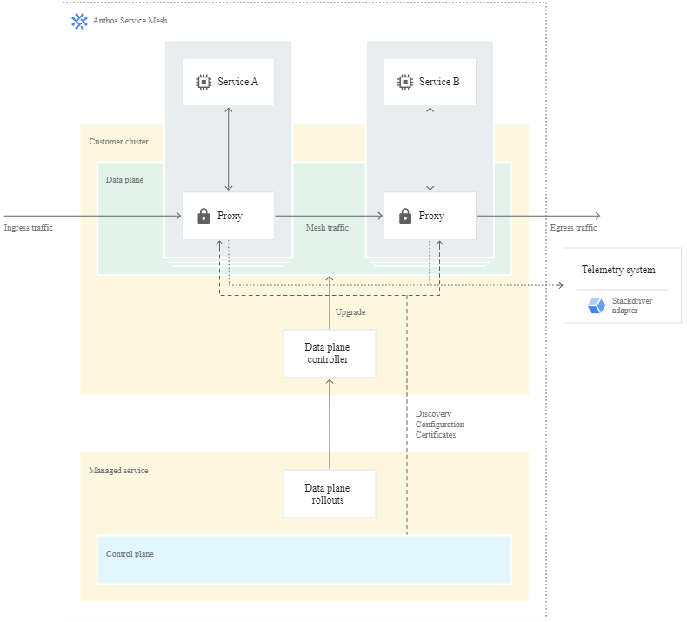
1
What is Anthos Service Mesh
A service mesh is an architecture that enables managed, observable, and secure communication across your services, letting you create robust enterprise applications made up of many microservices on your chosen infrastructure. Service meshes factor out all the common concerns of running a service such as monitoring, networking, and security, with consistent, powerful tools, making it easier for service developers and operators to focus on creating and managing great applications for their users.
Anthos Service Mesh is powered by Istio, a highly configurable and powerful open source service mesh platform, with tools and features that enable industry best practices. Anthos Service Mesh is deployed as a uniform layer across your entire infrastructure. Service developers and operators can use its rich feature set without making changes to application code.
What can we do with ASM?

Slide 3
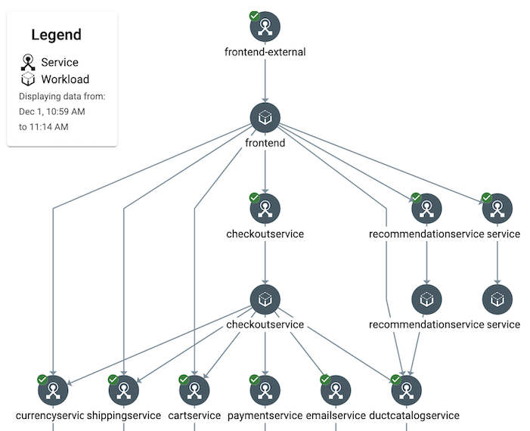
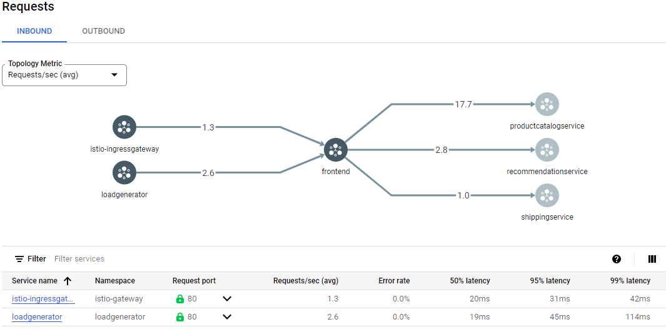
2
Better monitoring and SLOs
There is a service topology graph that shows your mesh's services and their relationships.
Also, we can get detailed information about the endpoints for each service, and see how traffic is flowing between services, and what performance looks like for each communication edge.

Slide 4
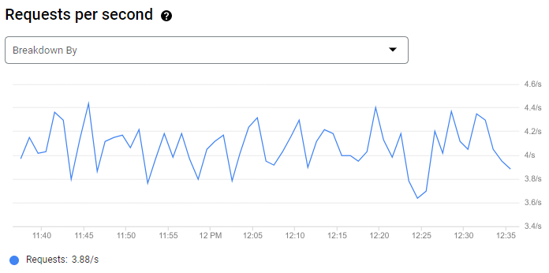
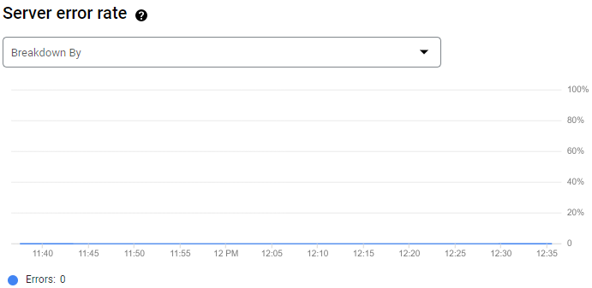
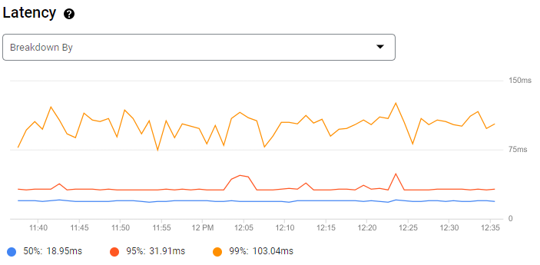
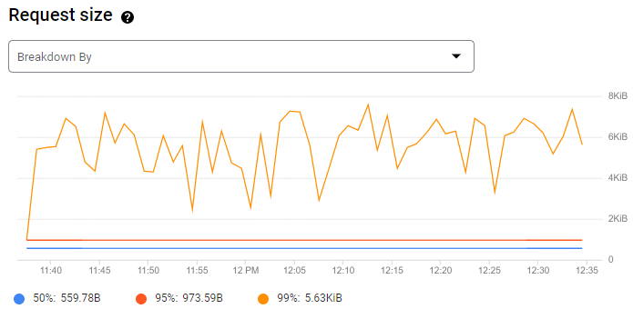
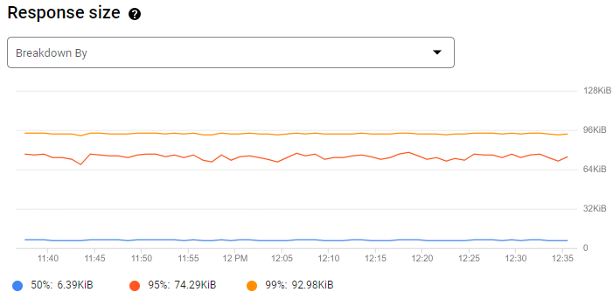
2
Better monitoring and SLOs
Anthos Service Mesh provides observability into the health and performance of your services. With this system, service developers don't have to instrument their code to collect telemetry data. On the Anthos Service Mesh pages in the Google Cloud console, you can get an overview of all services in your mesh, providing you critical, service-level metrics: latency, traffic, error rate, request/response size.

Slide 5
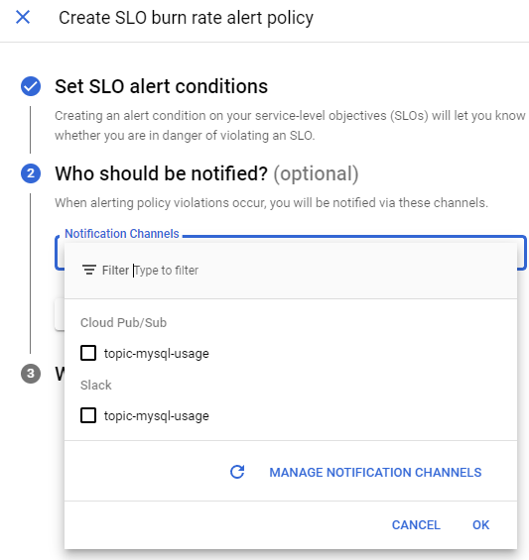
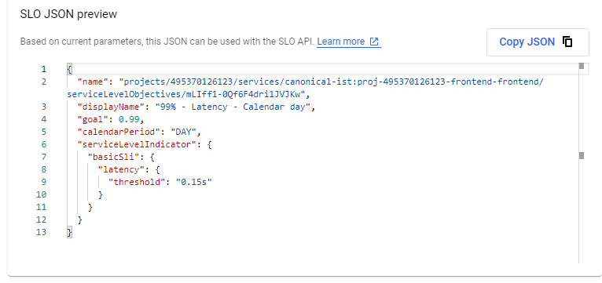
2
Better monitoring and SLOs
Based on above metrics, we can define, review, and set alerts against service level objectives (SLOs), which summarize your service's user-visible performance.

Slide 6
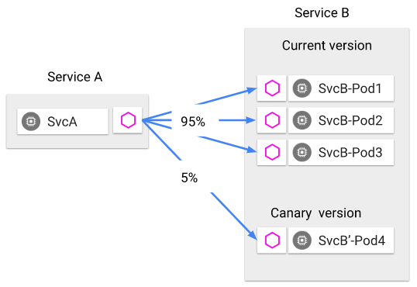
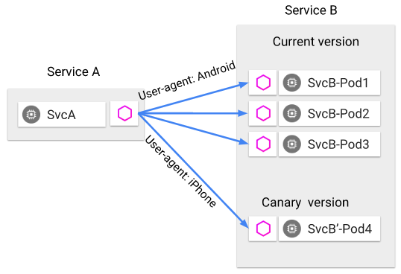
3
Canary deployments
Using ASM, we can create canary deployments.Traffic can be distributed according your configuration.
For example, we can specify that you want 5% of traffic for a particular service to go to a canary version irrespective of the size of the canary deployment, or send traffic to a particular version depending on the content of the request.

Slide 7
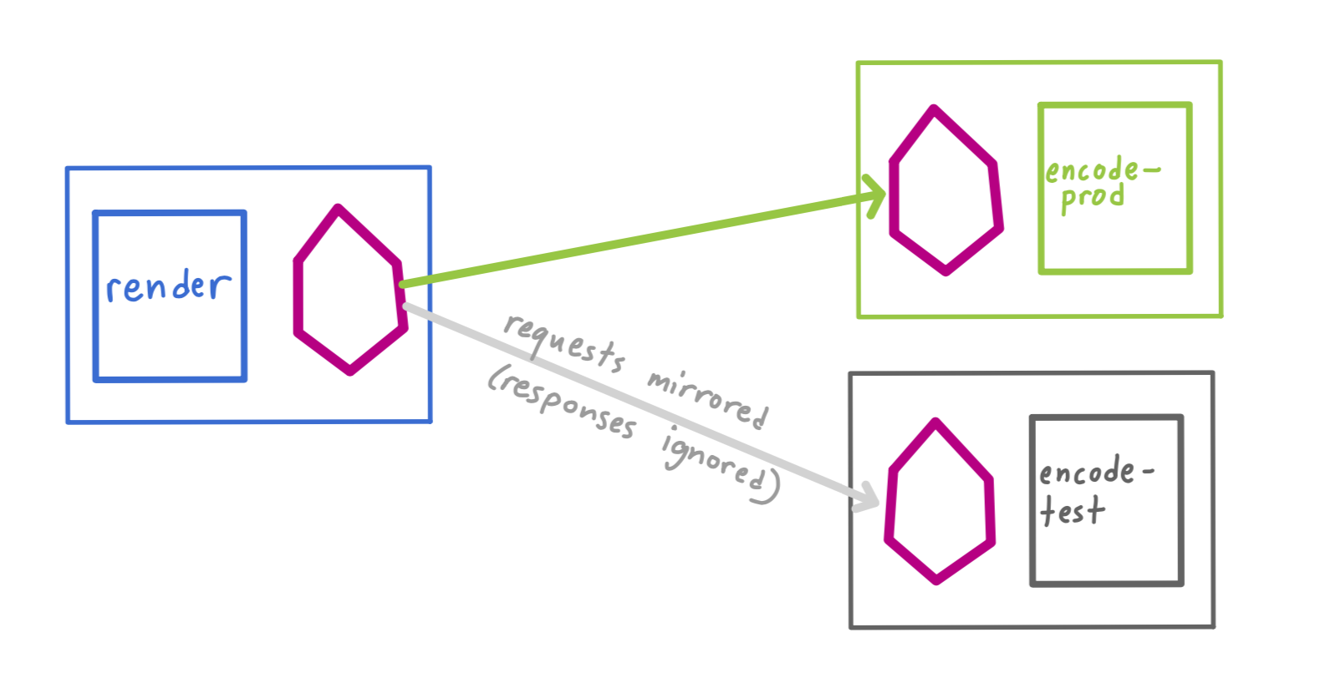
4
Traffic mirroring
ASM supports traffic mirroring, with it we can do shadow testing.
Using traffic mirroring to duplicate traffic to another service (maybe a new version). Also, it is important to note that these requests are mirrored as “fire and forget”, which means that the responses are discarded.
Practice:
We may be able to improve our publishing process using this feature.
We deploy the new version in advance, and configure traffic mirroring to the new version to observe whether there are problems in it without affecting the official function.
To be honest, we need to do some design to avoid issues to official data.

Slide 8
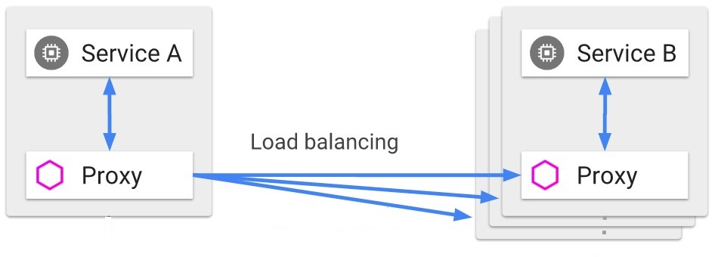
5
Load balancers
In kubernetes, the traffic received by the service will be distributed to the pods only according to the Round Robin policy.
In clusters with ASM on, we can configure load balance policy.
Supported load balancers are following:
Round robin
Weighted least request
Ring hash
Random

Slide 9
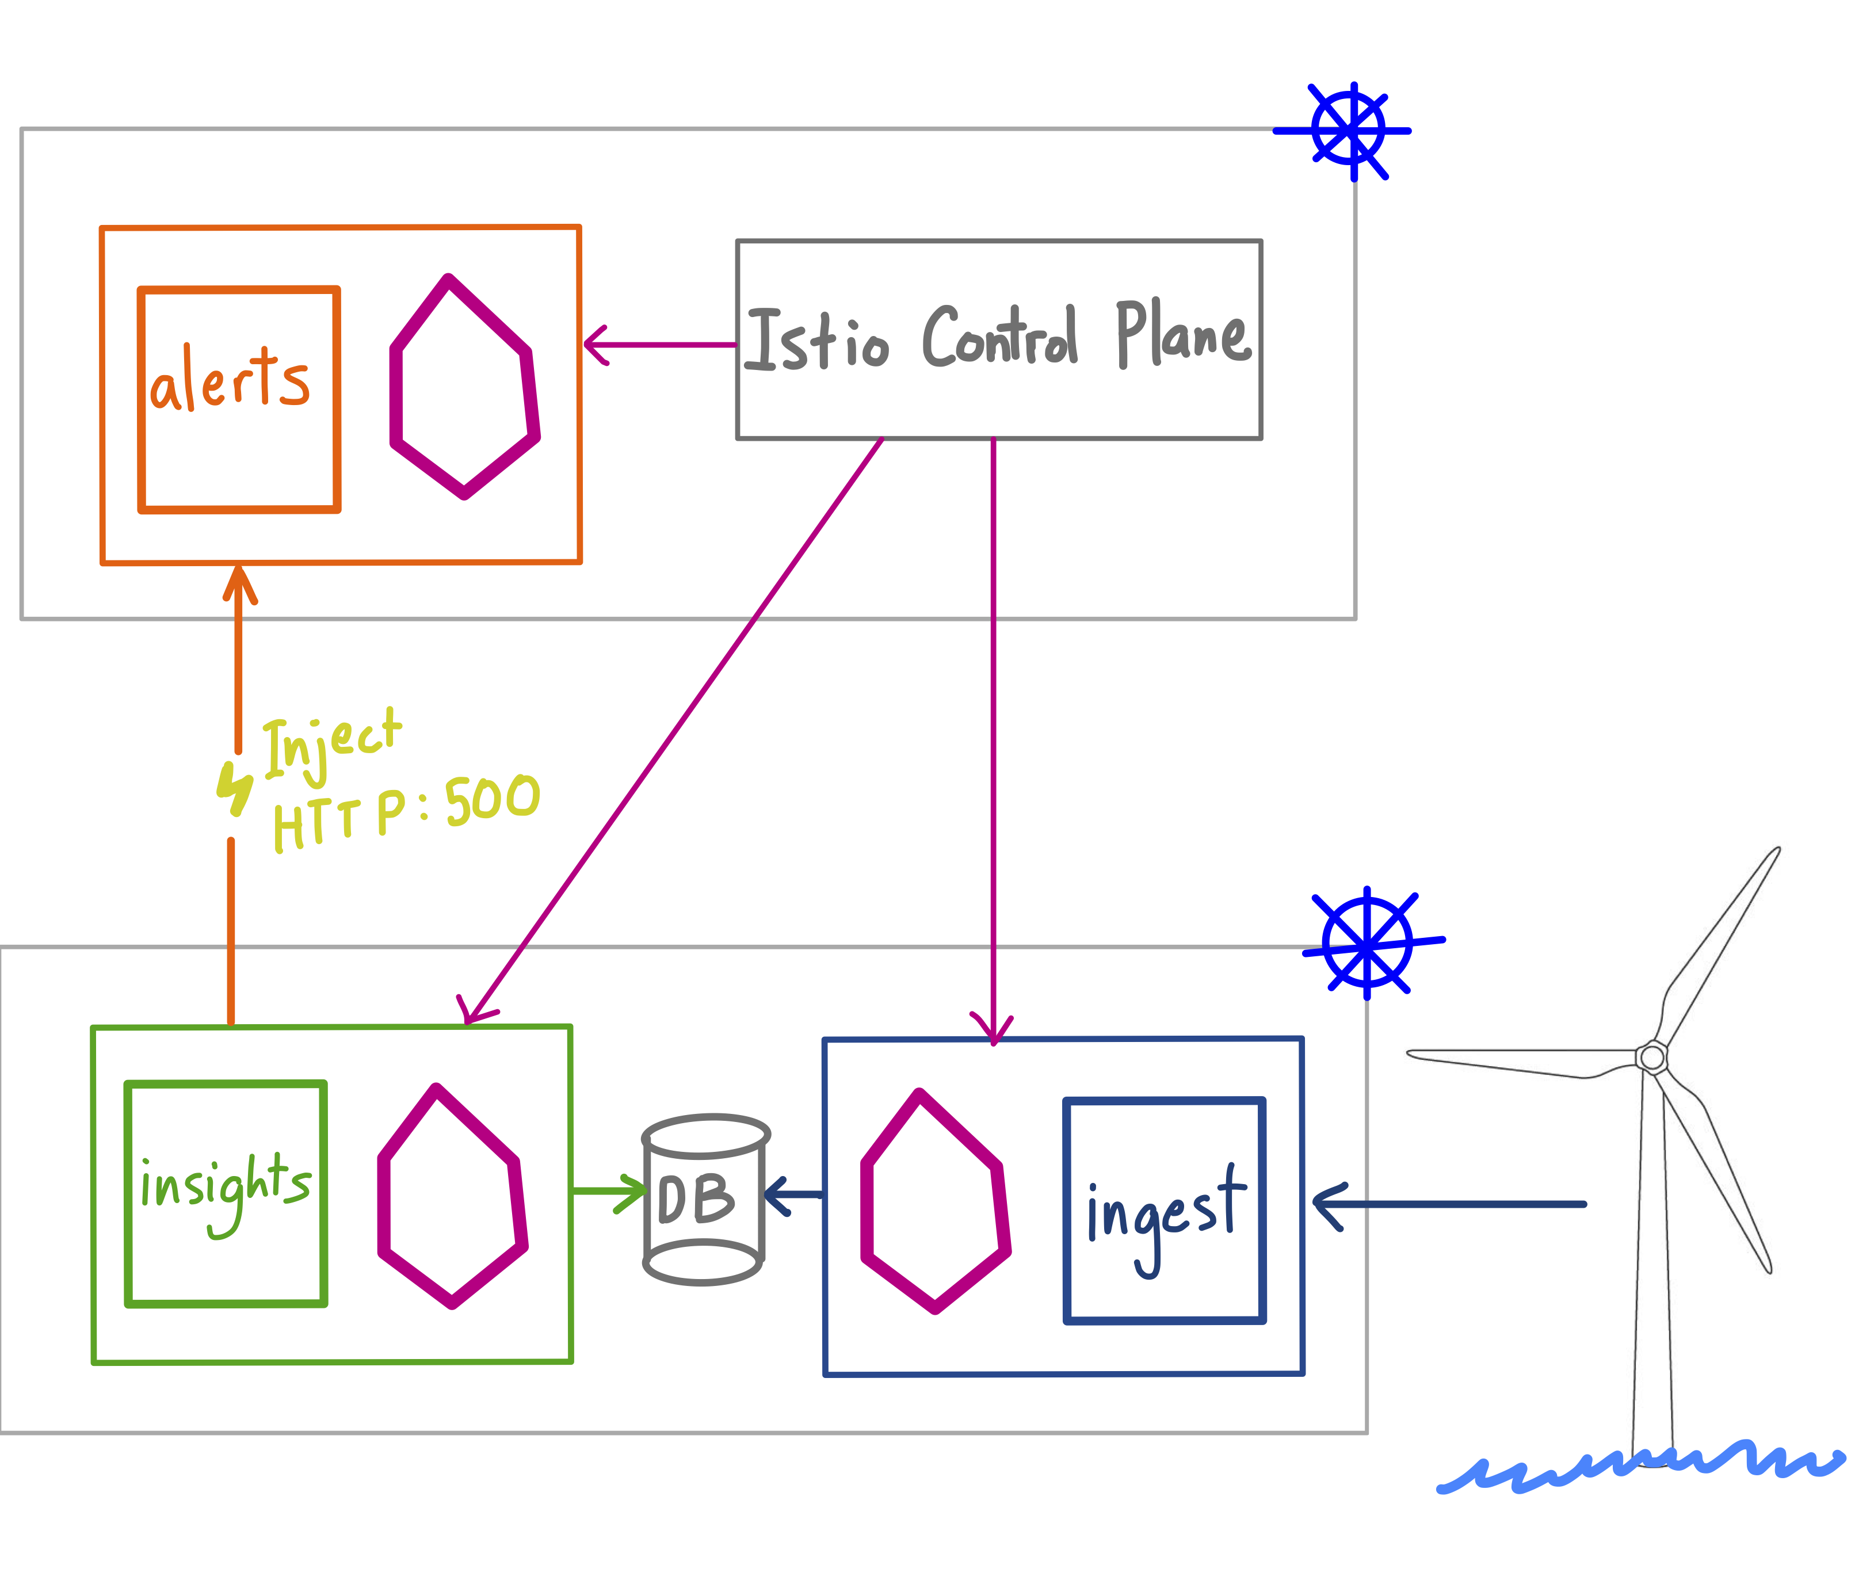
6
Fault injection
We can use Fault injection to do chaos testing at the application layer, by injecting timeouts or HTTP errors into our services, without actually updating your app code.
Note that we can customize these fault injection rules - for instance, fail multiple services at once (by adding more VirtualServices), fail only a percentage of requests, or fail only on certain HTTP request headers (like user-agent, to test the behavior on certain web browsers).

Slide 10
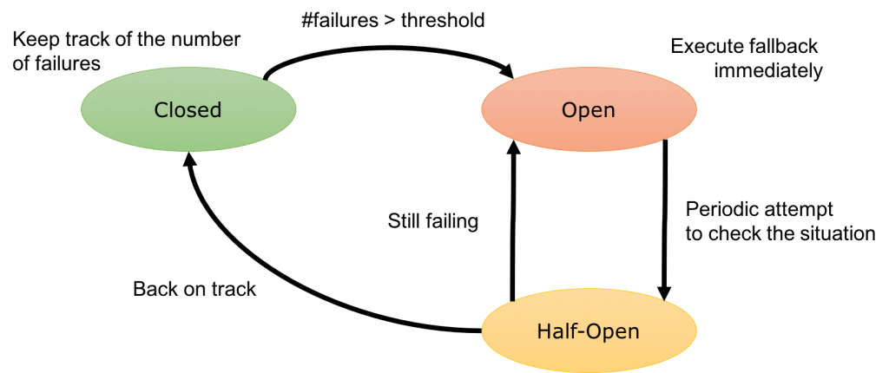
7
Circuit breakers
Circuit breakers are another useful mechanism Istio provides for creating resilient microservice-based applications. In a circuit breaker, you set limits for calls to individual hosts within a service, such as the number of concurrent connections or how many times calls to this host have failed. Once that limit has been reached the circuit breaker “trips” and stops further connections to that host. Using a circuit breaker pattern enables fast failure rather than clients trying to connect to an overloaded or failing host.
The circuit breaker is a proxy that controls flow to an endpoint. If the endpoint fails or is too slow (based on your configuration), the proxy will open the circuit to the container. In that case, traffic is routed to other containers. The circuit remains open for a preconfigured sleep window after which the circuit is considered "half-open". The next request attempted will determine if the circuit moves to "closed" (where everything is working again), or it it reverts to "open" and the sleep window starts again.
Practice:
Using circuit breaker, we can prevent an application instance from receiving too many requests after a high loading or a terrible error, causing the program to crash or tons of error logs.

Slide 11
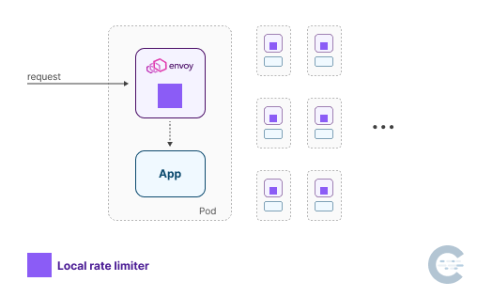
8
Rate limiting
Istio supports two kinds of rate limiting: global and local.
Local rate limiting is used to limit the rate of requests per service instance.
Envoy implements local rate limiting using a token bucket algorithm. The bucket keeps getting filled with tokens at a constant rate and when a request is sent to the service, a token is removed from the bucket. If the bucket is empty, the request gets rejected.

Slide 12
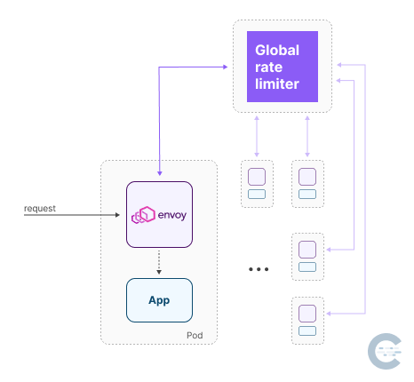
8
Rate limiting
Global rate limiting uses a global gRPC rate limiting service to provide rate limiting for the entire mesh. The global rate limiting is implemented using a central rate limiting service that's shared by all the services in the cluster.
In addition, bandwidth limit is also supported.
Practice:
Using local rate limiting and global rate limiting, we can prevent a service from being overloaded with requests, either from the same client IP or globally, from any client.
Also, we can use it to simulate a weak network environment.

Slide 13
9
Features
Traffic Management | Request Routing
 | Fault Injection
 | Traffic Shifting
 | Request Timeouts
 | Circuit Breaking
 | Mirroring
 | Locality Load Balancing
 | Ingress
 | Egress
Security | Certificate Management
 | Authentication
 | Authorization
 | TLS Configuration
Policy Enforcement | Enabling Rate Limits using Envoy
Observability | Metrics
 | Logs
 | Distributed Tracing
 | Visualizing Your Mesh
 | Remotely Accessing Telemetry Addons
 | Telemetry API
For further
Above are not the entire of ASM/Istio, it has many more features, I think we could take more time to investigate further, it will be very helpful to us.

